Slide 1
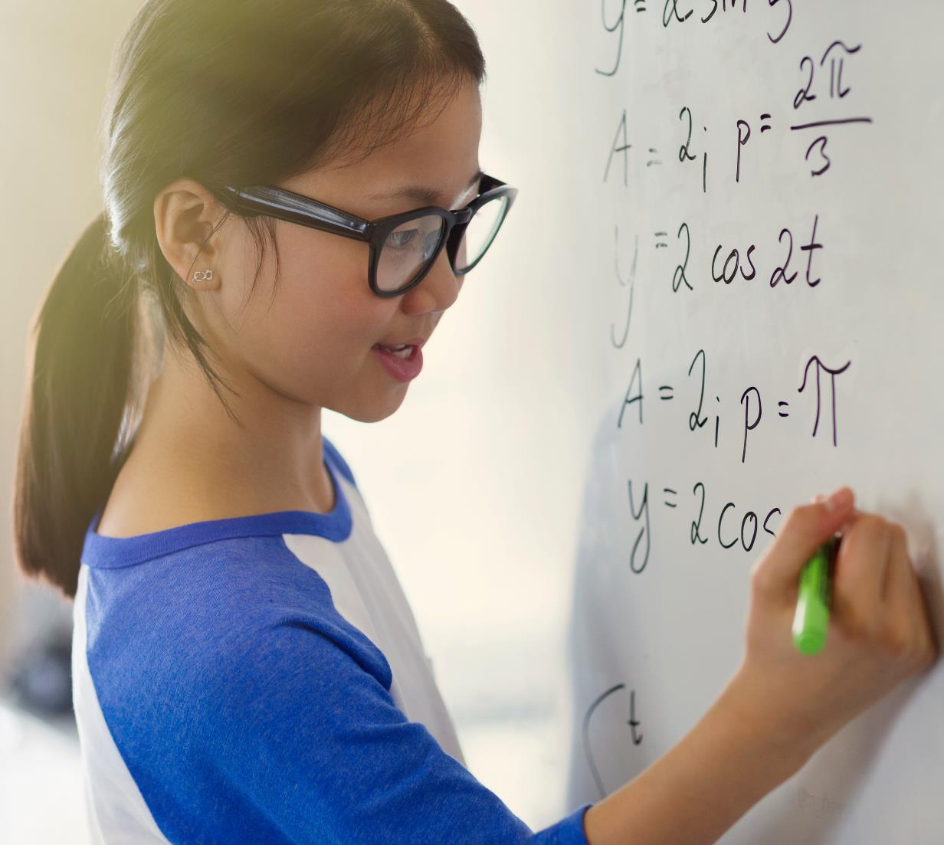
Programming Languages

Slide 2
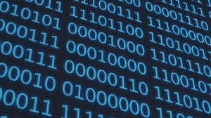
Computers
A computer understands 0 & 1 i.e. binary.

Slide 3
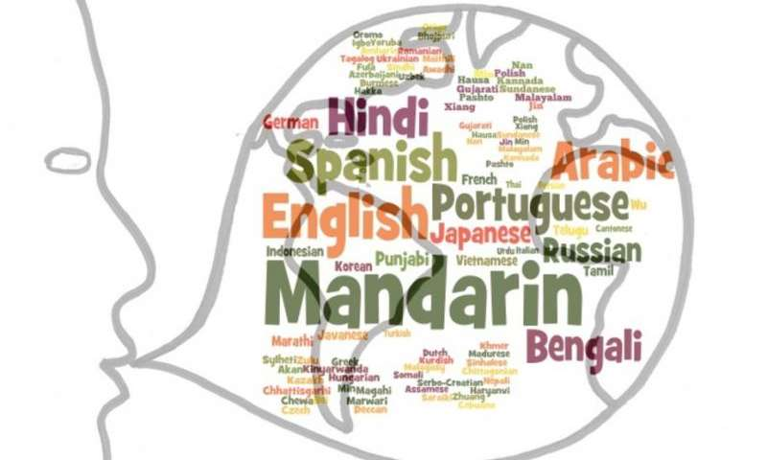
Humans
Humans understand and communicate in their own languages like Hindi, English,French

Slide 4
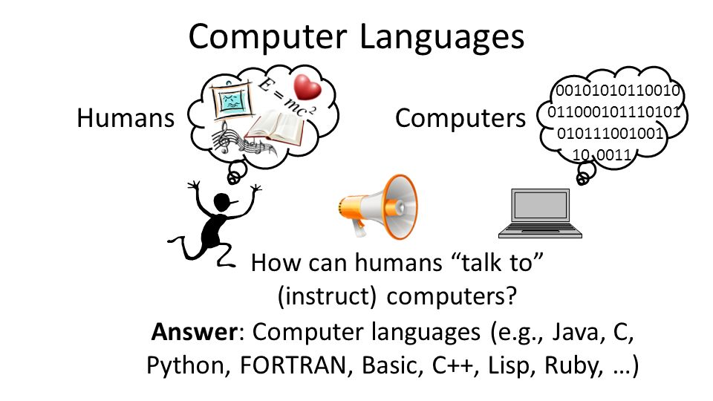
Programming Languages
In order for the humans to interact with the computer we need a programming language which both a computer and a human understand and are well versed with.

Slide 5
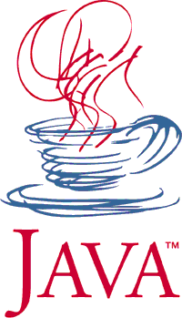
Java

Slide 6
Java Programming Language
One such language that we are studying in this course is Java.
Java language project was initiated by James Gosling, Mike Sheridan and Patrick Naughton at Sun Microsystems.
The language was initially known as Oak owing to the Oak tree that stood outside of James Goslings office. It later got renamed to project Green and finally Java after Java coffee, the coffee from Indonesia.
Syntax of Java is largely influenced by C/C++ syntax.
One of the key features was that it was Write once,run anywhere(WORA) piece of software. This meant a Java program could be run on a wide variety of machines without having to compile it again.
Java was initially owned by Sun Microsystems but gradually it got acquired by Oracle Corporation in the year.

Slide 7
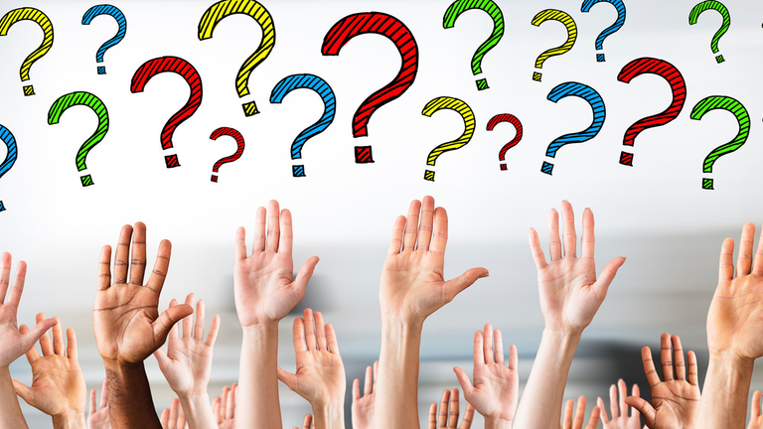
Questions ??

